Slide 1
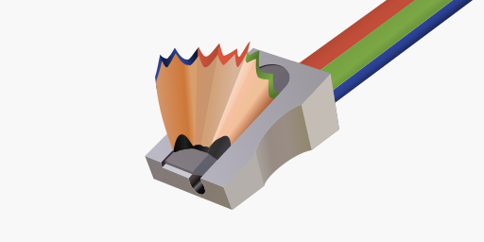
Looking at SkiaSharp Issues

